Slide 1

Project - Movement
Computer Graphics
MIEIC
Basic animation
Teresa Matos
23-24 March 2020

Slide 2
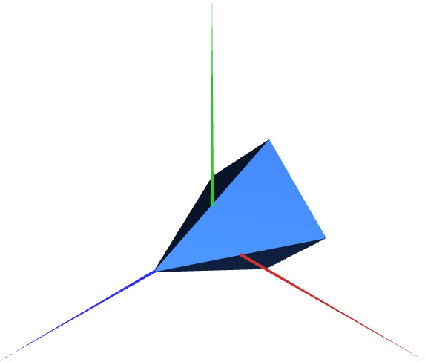
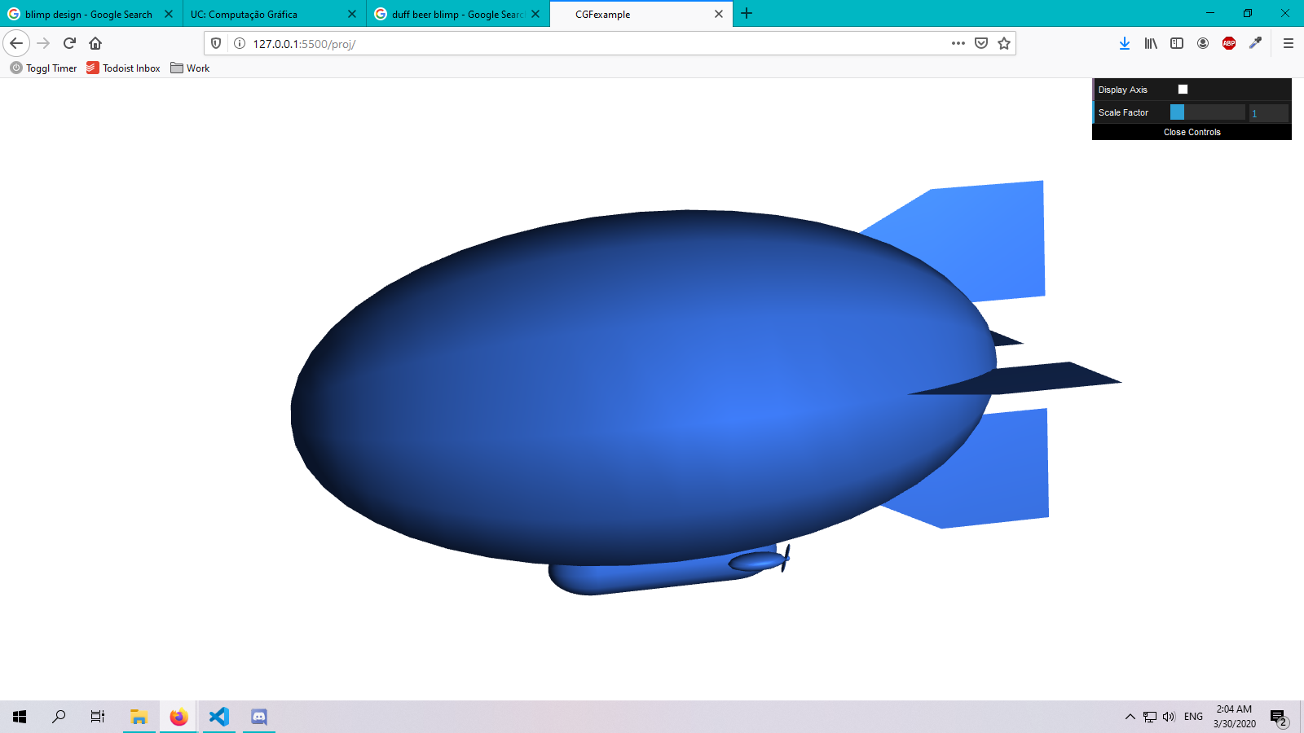
MyVehicle
Object in scene controllable by user through key presses
Default state of vehicle is:
Stationary (no speed)
Centered in origin (0,0,0)
Front towards positive Z axis

Slide 3
Steps for vehicle animation
The worksheet for the project delineates different steps to apply animation
The steps in the vehicle’s class can be broken down into three phases:
Define default state
Update current state
Apply state in vehicle’s display

Slide 4
1 Define Default State - Variables
In the constructor, we add the variables that describe the default state.
Default state of vehicle is:
Stationary (no speed)
Centered in origin (0,0,0)
Front towards positive Z axis
constructor(...){
…
this.speed = 0;
this.position = [0,0,0];
this.orientation = 0;
}

Slide 5
2 Update Current State
The 3 variables that define the vehicle’s state are updated/changed differently
The speed and orientation are updated only with user input (key presses)
The position of the vehicle periodically (according to scene’s update period)

Slide 6
2 Update Current State - Orientation
The vehicle’s orientation is related to its rotation around the Y axis
The orientation’s value changes when the ‘A’ or ‘D’ keys are pressed
‘D’ key
‘A’ key

Slide 7
2 Update Current State - Position
The vehicle only moves in X and Z axis (Y is always 0)
At any given moment, we want to move the vehicle:
from its current position
In the direction it is facing (according to orientation)
update(){
position = position + directionVector
}

Slide 8
2 Update Current State - Position
We calculate the directional vector using the current orientation
directionVector.x = sin(orientation)
directionVector.y = 0
directionVector.x = cos(orientation)
x
z
Directional vector, considering initial orientation = +Z direction

Slide 9
2 Update Current State - Speed
The speed of the vehicle influences the amount of movement (distance)
Multiplying a vector by a scalar changes the magnitude of that vector
update(){
position = position + directionVector * speed
}
Directional vector (unitary magnitude)
Scaled directional vector (scalar > 1)

Slide 10
3 Apply state in display
In the vehicle’s display() function, we apply the geometric transformations to animate the 3D object(s)
display(){
translate(position);
objects.display();
}
Is it enough to apply translation?

Slide 11
3 Apply state in display
In the vehicle’s display() function, we apply the geometric transformations to animate the 3D object(s)
display(){
translate(position);
rotate(orientation);
objects.display();
}
We need to rotate the vehicle before positioning it.

